Slide 1
Use of Computer vision and Deep Learning to control Lego Mindstorms robots
Timofey Melnikov
Evgenya Stepyreva
Mentor : Evgene Smirnov
Manager: Vasiliy Buzoverya
SSG/DPD/VCP
13.07.2016

Slide 2
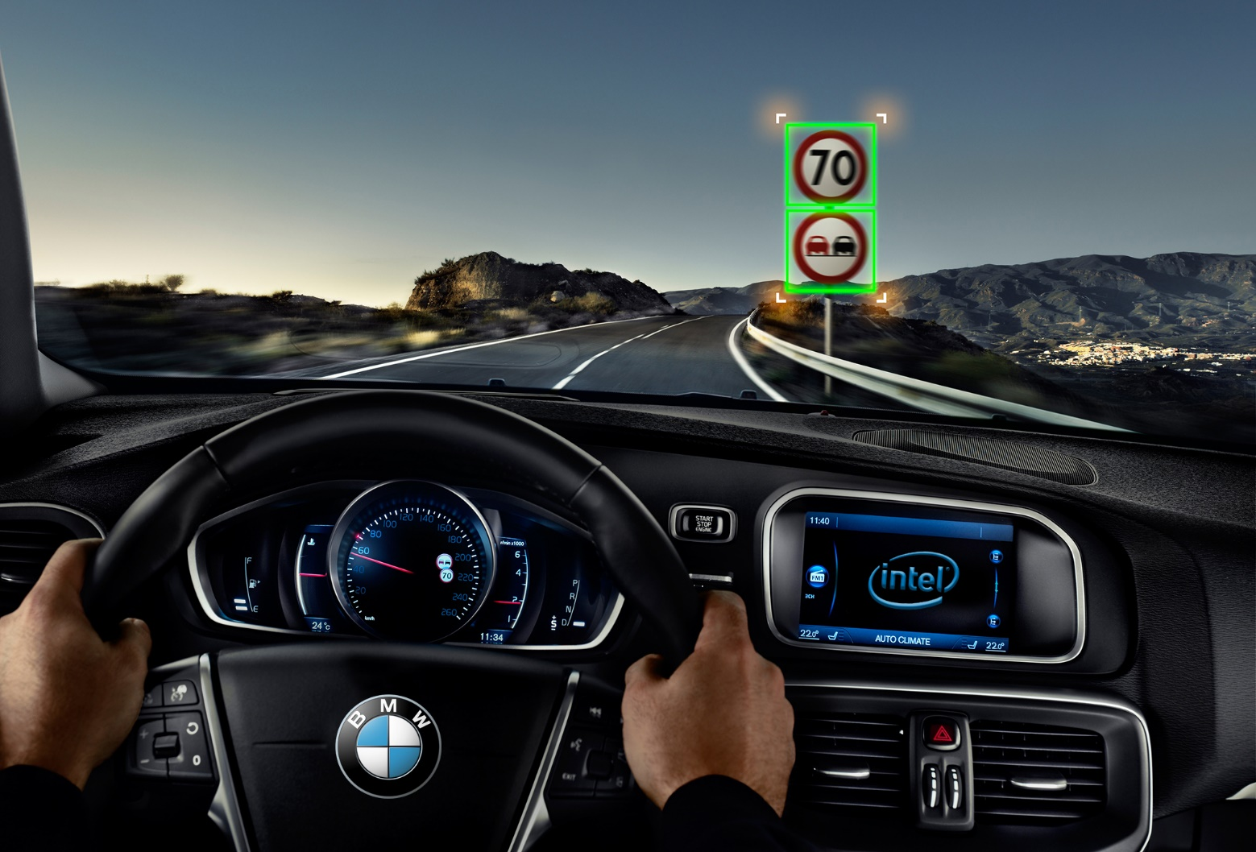
Problem Overview

Slide 3
Task Description
Use PixyCam | Use USB WebCam
Train LeNet on MNIST with Caffe
Implement NN scoring on Pixy HW using Intel tools (Intel DAAL or Intel MKL-DNN) | Implement NN scoring on Lego EV3 HW using Intel tools (Intel DAAL or Intel MKL-DNN)
Control Lego robot using image analytics
Notes:
Intel DAAL -

Slide 4
Expected Deliverables and Timeline
Deliverable | Date
Analyze PixyCam Firmware source code | WW30
Train LeNet on MNIST with Caffe | WW31
Implement NN scoring on PixyCam (Lego EV3 HW) | WW32
Control Lego robot | WW33
Report result | WW34

Slide 5
Questions?

